Slide 1
INST 346 Spring 2025
Lectures 25-26
April 28 and 30, 2025
Professor Keith Marzullo

Slide 2
Network security key points
What is network security?
Principles of cryptography
Message integrity, authentication

Slide 3
What is network security?
confidentiality: only sender, intended receiver should “understand” message contents
sender encrypts message
receiver decrypts message
authentication: sender, receiver want to confirm identity of each other
message integrity: sender, receiver want to ensure message not altered (in transit, or afterwards) without detection
access and availability: services must be accessible and available to users

Slide 4



Friends and enemies: Alice, Bob, Trudy
well-known in network security world
Bob, Alice want to communicate “securely”
Trudy (intruder) may intercept, delete, add messages
Alice
channel
data, control messages
Bob
secure
sender
secure
receiver
data
data
Trudy

Slide 5
Friends and enemies: Alice, Bob, Trudy
Who might Bob and Alice be?
… well, real-life Bobs and Alices!
Web browser/server for electronic transactions (e.g., on-line purchases)
on-line banking client/server
DNS servers
BGP routers exchanging routing table updates
many other examples

Slide 6
What can adversaries do?
eavesdrop: intercept messages
actively insert messages into connection
impersonation: can fake (spoof) source address in packet (or any field in packet)
hijacking: “take over” ongoing connection by removing sender or receiver, inserting himself in place
denial of service: prevent service from being used by others (e.g., by overloading resources)

Slide 7
Network security key points
What is network security?
Principles of cryptography
Message integrity, authentication

Slide 8
The language of cryptography
Alice’s
encryption
key
Bob’s
decryption
key
K
A
K
B
plaintext
encryption
algorithm
ciphertext
decryption
algorithm
plaintext
m: plaintext message
K_{A}(m): ciphertext, encrypted with key K_{A}
m = K_{B}(K_{A}(m))
K_{B}(m’) for m’ not encrypted by K_{A} is detectable as such

Slide 9
Breaking an encryption scheme
cipher-text only attack: Trudy has ciphertext she can analyze
two approaches:
brute force: search through all keys
statistical analysis
known-plaintext attack: Trudy has plaintext corresponding to ciphertext
e.g., in monoalphabetic cipher, Trudy determines pairings for a,l,i,c,e,b,o,
chosen-plaintext attack: Trudy can get ciphertext for chosen plaintext

Slide 10
Symmetric key cryptography
K
K
S
S
plaintext
encryption
algorithm
ciphertext
decryption
algorithm
plaintext
K (m)
S
symmetric key crypto: Bob and Alice share same (symmetric) key: K
e.g., key is knowing substitution pattern in mono alphabetic substitution cipher
Q: how do Bob and Alice agree on key value?

Slide 11
Simple encryption scheme
substitution cipher: substituting one thing for another
monoalphabetic cipher: substitute one letter for another
plaintext: abcdefghijklmnopqrstuvwxyz
ciphertext: mnbvcxzasdfghjklpoiuytrewq
e.g.:
Plaintext: we attack at noon
ciphertext: rc muumbf mu jkkj
Encryption key: mapping from set of 26 letters
to set of 26 letters

Slide 12
A more sophisticated encryption approach
n substitution ciphers, M₁,M₂,…,M_{n}
cycling pattern:
e.g., n=4: M₁,M₃,M₄,M₃,M₂; M₁,M₃,M₄,M₃,M₂; ..
for each new plaintext symbol, use subsequent substitution pattern in cyclic pattern
doggo: d from M₁, o from M₃, g from M₄, g from M₂, o from M₁
Encryption key: n substitution ciphers, and cyclic pattern
key need not be just n-bit pattern

Slide 13
Symmetric key crypto: DES
DES: Data Encryption Standard
US encryption standard [NIST 1993]
56-bit symmetric key, 64-bit plaintext input
block cipher with cipher block chaining
how secure is DES?
DES Challenge: 56-bit-key-encrypted phrase decrypted (brute force) in less than a day
no known good analytic attack
making DES more secure:
3DES: encrypt 3 times with 3 different keys

Slide 14
AES: Advanced Encryption Standard
symmetric-key NIST standard, replaced DES (Nov 2001)
processes data in 128 bit blocks
128, 192, or 256 bit keys
brute force decryption (try each key) taking 1 sec on DES, takes 149 trillion years for AES

Slide 15

Public Key Cryptography
symmetric key crypto:
requires sender, receiver know shared secret key
Q: how to agree on key in first place (particularly if never “met”)?
public key crypto
radically different approach [Diffie-Hellman76, RSA78]
sender, receiver do not share secret key
public encryption key known to all
private decryption key known only to receiver

Slide 16
Public Key Cryptography
+
Bob’s public key
K
B
-
Bob’s private key
K
B
plaintext
message, m
encryption
algorithm
ciphertext
decryption
algorithm
plaintext
+
-
+
K (m)
m = K (K (m))
B
B
B
Public key cryptography revolutionized 2000-year-old (previously only symmetric key) cryptography!
similar ideas emerged at roughly same time, independently in US and UK (classified)

Slide 17


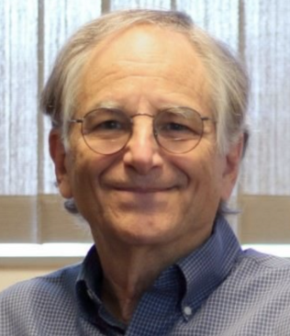
Public key encryption algorithms
requirements:
+
.
-
.
1
need K ( ) and K ( ) such that
B
B
-
+
K (K (m)) = m
B
B
+
2
given public key K , it should be impossible to compute private key K
B
-
B
RSA algorithm: Ron Rivest, Adi Shamir, and Leonard Adleman (1977)

Slide 18
Network security key points
What is network security?
Principles of cryptography
Message integrity, authentication

Slide 19
Authentication
Goal: Bob wants Alice to “prove” her identity to him
Protocol ap1.0: Alice says “I am Alice”
“I am Alice”
failure scenario??

Slide 20
Authentication
Goal: Bob wants Alice to “prove” her identity to him
Protocol ap1.0: Alice says “I am Alice”
in a network, Bob can not “see” Alice, so Trudy simply declares herself to be Alice
“I am Alice”

Slide 21
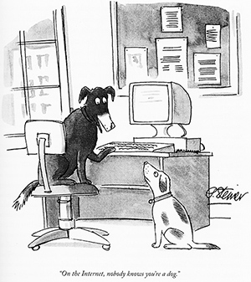
Authentication
Goal: Bob wants Alice to “prove” her identity to him
Protocol ap1.0: Alice says “I am Alice”
in a network, Bob can not “see” Alice, so Trudy simply declares herself to be Alice
“I am Alice”

Slide 22
Authentication: another try
Goal: Bob wants Alice to “prove” her identity to him
Protocol ap2.0: Alice says “I am Alice” in an IP packet containing her source IP address
Alice’s
IP address
“I am Alice”
failure scenario??

Slide 23
Authentication: another try
Goal: Bob wants Alice to “prove” her identity to him
Protocol ap2.0: Alice says “I am Alice” in an IP packet containing her source IP address
Trudy can create
a packet “spoofing”
Alice’s address
Alice’s
IP address
“I am Alice”

Slide 24
Authentication: a third try
Goal: Bob wants Alice to “prove” her identity to him
Protocol ap3.0: Alice says “I am Alice” and sends her secret password to “prove” it.
Alice’s
IP addr
Alice’s
password
“I am Alice”
failure scenario??
Alice’s
IP addr
OK

Slide 25
Authentication: a third try
Goal: Bob wants Alice to “prove” her identity to him
Protocol ap3.0: Alice says “I am Alice” and sends her secret password to “prove” it.
Alice’s
IP addr
Alice’s
password
“I am Alice”

Slide 26
Authentication: a third try
Goal: Bob wants Alice to “prove” her identity to him
Protocol ap3.0: Alice says “I am Alice” and sends her secret password to “prove” it.
playback attack: Trudy records Alice’s packet
and later
plays it back to Bob
Alice’s
IP addr
Alice’s
password
“I am Alice”
Alice’s
IP addr
OK

Slide 27
Authentication: a modified third try
Goal: Bob wants Alice to “prove” her identity to him
Protocol ap3.0: Alice says “I am Alice” and sends her encrypted secret password to “prove” it.
Alice’s
IP addr
encrypted
password
“I am Alice”
failure scenario??
Alice’s
IP addr
OK

Slide 28
Authentication: a modified third try
Goal: Bob wants Alice to “prove” her identity to him
Protocol ap3.0: Alice says “I am Alice” and sends her encrypted secret password to “prove” it.
Alice’s
IP addr
encrypted
password
“I am Alice”

Slide 29
Authentication: a modified third try
Goal: Bob wants Alice to “prove” her identity to him
Protocol ap3.0: Alice says “I am Alice” and sends her encrypted secret password to “prove” it.
playback attack still works: Trudy records Alice’s packet
and later plays it back to Bob
Alice’s
IP addr
encrypted
password
“I am Alice”
Alice’s
IP addr
OK

Slide 30
Authentication: a fourth try
Goal: avoid playback attack
nonce: number (R) used only once in a lifetime
protocol ap4.0: to prove Alice “live”, Bob sends Alice nonce, R
Alice must return R, encrypted with shared secret key
“I am Alice”

Slide 31
Authentication: a fourth try
Goal: avoid playback attack
nonce: number (R) used only once in a lifetime
protocol ap4.0: to prove Alice “live”, Bob sends Alice nonce, R
Alice must return R, encrypted with shared secret key
“I am Alice”
R

Slide 32
Authentication: a fourth try
Goal: avoid playback attack
nonce: number (R) used only once in a lifetime
protocol ap4.0: to prove Alice “live”, Bob sends Alice nonce, R
Alice must return R, encrypted with shared secret key
“I am Alice”
R
K (R)
Bob know Alice is live, and only Alice knows key to encrypt nonce, so it must be Alice!
A-B
Failures, drawbacks?

Slide 33
Authentication: ap5.0
ap4.0 requires shared symmetric key - can we authenticate using public key techniques?
ap5.0: use nonce, public key cryptography
“I am Alice”
R
Bob computes
+
-
-
K
(K (R)) = R
K (R)
A
A
A
and knows only Alice could have the private key, that encrypted R such that
Send me your public key
+
K (R)
+
-
A
K
A
(K (R)) = R
A

Slide 34
Authentication: ap5.0 – there’s still a flaw!
man (or woman) in the middle attack: Trudy poses as Alice (to Bob) and as Bob (to Alice)
I am Alice
I am Alice
R
-
K (R)
T
Send me your public key
+
K
Bob computes
T
+
-
K
(K (R)) = R,
T
T
authenticating
Trudy as Alice

Slide 35
Authentication: ap5.0 – there’s still a flaw!
man (or woman) in the middle attack: Trudy poses as Alice (to Bob) and as Bob (to Alice)
R
-
K (R)
A
Send me your public key
+
K
A

Slide 36
Authentication: ap5.0 – there’s still a flaw!
man (or woman) in the middle attack: Trudy poses as Alice (to Bob) and as Bob (to Alice)
Trudy recovers m:
+
-
+
K (m)
m = K (K (m))
T
Bob sends a personal message, m to Alice
T
T

Slide 37
Authentication: ap5.0 – there’s still a flaw!
man (or woman) in the middle attack: Trudy poses as Alice (to Bob) and as Bob (to Alice)
Where are mistakes made here?
Trudy recovers Bob’s m:
+
Trudy sends m to Alice encrypted with Alice’s public key
-
+
K (m)
m = K (K (m))
A
A
A
and she and Bob meet a week later in person and discuss m, not knowing Trudy knows m

Slide 38

Digital signatures
cryptographic technique analogous to hand-written signatures:
sender (Bob) digitally signs document: he is document owner/creator.
verifiable, nonforgeable: recipient (Alice) can prove to someone that Bob, and no one else (including Alice), must have signed document
simple digital signature for message m:
Bob signs m by encrypting with his private key K_{B}⁻, creating “signed” message, K_{B}⁻(m)
-
Bob’s private
key
-
Bob’s message, m
K
m,K
(m)
B
B
Dear Alice
Oh, how I have missed you. I think of you all the time! …(blah blah blah)
Bob
Dear Alice
Oh, how I have missed you. I think of you all the time! …(blah blah blah)
Bob
Public key
encryption
algorithm
-
K
(m)
B

Slide 39
Digital signatures
-
suppose Alice receives msg m, with signature: m, K_{B}(m)
Alice verifies m signed by Bob by applying Bob’s public key K_{B} to K_{B}(m) then checks K_{B}(K_{B}(m) ) = m.
If K_{B}(K_{B}(m) ) = m, whoever signed m must have used Bob’s private key
+
-
+
-
+
-
Alice thus verifies that:
Bob signed m
no one else signed m
Bob signed m and not m’
non-repudiation:
Alice can take m, and signature K_{B}(m) to court and prove that Bob signed m
-

Slide 40
Message digests
computationally expensive to public-key-encrypt long messages
goal: fixed-length, easy- to-compute digital “fingerprint”
apply hash function H to m, get fixed size message digest, H(m)
large
message
m
H: Hash
Function
H(m)
Hash function properties:
many-to-1
produces fixed-size message digest (fingerprint)
given message digest x, computationally infeasible to find m such that x = H(m)

Slide 41
Internet checksum: poor crypto hash function
Internet checksum has some properties of hash function:
produces fixed length digest (16-bit sum) of message
is many-to-one
but given message with given hash value, it is easy to find another message with same hash value:
message
ASCII format
message
ASCII format
I O U 1
0 0 . 9
9 B O B
49 4F 55 31
30 30 2E 39
39 42 D2 42
I O U 9
0 0 . 1
9 B O B
49 4F 55 39
30 30 2E 31
39 42 D2 42
B2 C1 D2 AC
different messages
but identical checksums!
B2 C1 D2 AC

Slide 42
Digital signature = signed message digest
Bob sends digitally signed message:
Alice verifies signature, integrity of digitally signed message:
large
message
m
H: Hash
Function
H(m)
encrypted
message digest
-
K_{B}(H(m))
digital
signature
(encrypt)
Bob’s
private
key
large
message
m
-
K
B
digital
signature
(decrypt)
Bob’s
public
key
+
encrypted
message digest
H: Hash
function
K
B
+
-
K_{B}(H(m))
H(m)
H(m)
equal?

Slide 43
Hash function algorithms
MD5 hash function widely used (RFC 1321)
computes 128-bit message digest in 4-step process.
arbitrary 128-bit string x, appears difficult to construct msg m whose MD5 hash is equal to x
SHA-1 is also used
US standard [NIST, FIPS PUB 180-1]
160-bit message digest

Slide 44
Authentication: ap5.0 – let’s fix it!!
Recall the problem: Trudy poses as Alice (to Bob) and as Bob (to Alice)
I am Alice
I am Alice
R
-
K (R)
T
R
Where are mistakes made here?
Send me your public key
-
+
K (R)
K
Bob computes
A
T
+
-
Send me your public key
K
(K (R)) = R,
+
T
T
K
authenticating
Trudy as Alice
A
Trudy recovers m:
+
+
-
+
K (m)
Trudy recovers Bob’s m:
m = K (K (m))
Bob sends a personal message, m to Alice
-
+
K (m)
T
T
m = K (K (m))
A
T
A
A
sends m to Alice encrypted with Alice’s public key
and she and Bob meet a week later in person and discuss m, not knowing Trudy knows m

Slide 45
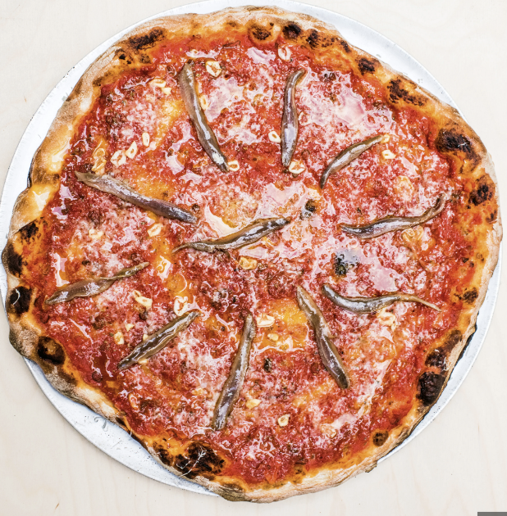
Need for certified public keys
motivation: Trudy plays pizza prank on Bob
Trudy creates e-mail order: Dear Pizza Store, Please deliver to me four anchovy pizzas. Thank you, Bob
Trudy signs order with her private key
Trudy sends order to Pizza Store
Trudy sends to Pizza Store her public key, but says it’s Bob’s public key
Pizza Store verifies signature; then delivers four anchovy pizzas to Bob
Bob doesn’t even like anchovies

Slide 46
Public key Certification Authorities (CA)
certification authority (CA) binds public key to particular entity E
entity (person, website, router) registers its public key with CE provides “proof of identity” to CA
CA creates certificate binding identity E to E’s public key
certificate containing E’s public key digitally signed by CA: CA says “this is E’s public key”
Bob’s
public
key
digital
signature
(encrypt)
+
+
K
K
B
B
CA’s
private
key
-
certificate for Bob’s public key, signed by CA
Bob’s
identifying information
K
CA

Slide 47
Public key Certification Authorities (CA)
when Alice wants Bob’s public key:
gets Bob’s certificate (Bob or elsewhere)
apply CA’s public key to Bob’s certificate, get Bob’s public key
+
digital
signature
(decrypt)
Bob’s
public
key
K
+
B
K
B
CA’s
public
key
+
K
CA

Slide 48
Network security summary
What is network security?
Principles of cryptography
Message integrity, authentication

